Slide 1



How to become a Quant?
What, How, Why
by Nicholas Burgess

Slide 2
Quant Career Roadmap
What
01
How
02
Why
03

Slide 3
What is a Quant?
Quantitative finance is a highly lucrative and intellectually stimulating field at the intersection of mathematics, computer science, and finance that focuses on using rigorous quantitative methods to analyse and predict financial markets.
Professionals in this arena, known as ‘Quants’, develop and implement mathematical models, sophisticated algorithms, and data-driven strategies to gain insights into financial behaviours, optimize trading, and manage financial risk.

Slide 4

What do Quants do?
Quants work at hedge funds, proprietary trading firms, asset management companies (the ‘Buy Side’) or investment banks (the ‘Sell Side’).
Sell-Side – Investment Banks, Fair Value, Models, Risk Management, C++
Buy-Side – Hedge Funds, Trading Strategies, Prediction, Machine Learning, Python

Slide 5
Different Types of Quant
Quant Traders
- Design, implement, and execute algorithmic trading strategies, often with a focus on automation and market efficiency.
Quant Researchers
- Develop mathematical models to predict market movements. Predominantly found on the buy side, they leverage Python for predictive analytics, machine learning, and AI-driven research.
Quant Analysts
- Build and maintain pricing models and risk analytics for trading desks. Typically, on the sell side, they use C++ to deliver low-latency solutions for electronic market making, live risk management, and present value calculations.
Quant Strategists
- Work closely with trading teams to provide quantitative models, pricing, and risk support, bridging the gap between research and execution.
Quant Developers
- Design the software and technology infrastructure that enables traders to implement and risk manage trading strategies efficiently and securely.

Slide 6
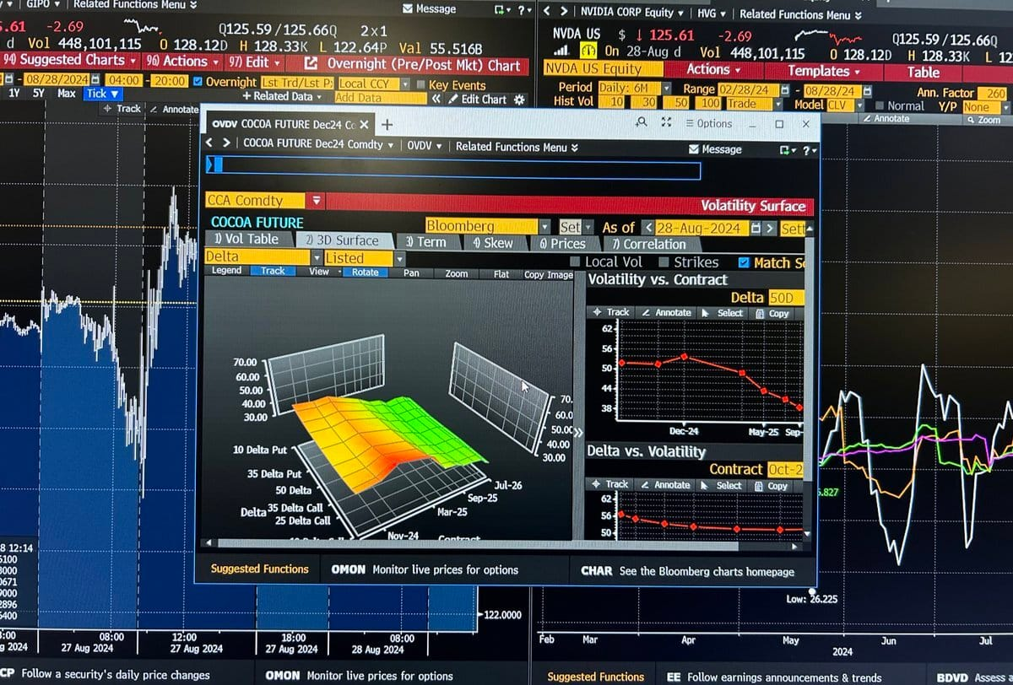
How to become a Quant?

Slide 7
Becoming a Quant
Educational Background
– An undergraduate degree (BSc.) in a STEM field such as Mathematics, Engineering, Computer Science, Physics, Finance is required and a postgraduate master’s degree (MSc.) in Financial Engineering.
Essential Skills
– Probability & Statistics, Stochastic Calculus, Linear Algebra, Optimization Techniques …
Programming Knowledge
– Proficiency in C++ for ‘Sell Side’ and Python for ‘Buy-Side’ roles respectively. Often both required.
Financial Knowledge
– An understanding of financial instruments and market micro structure is required. Popular concepts include: the Black-Scholes model, Volatility Models (e.g. Local Vol, SABR, Heston, Stochastic Local Vol), Market Microstructure and Order Book Dynamics, Yield Curve Models, Bond, Swap, Credit and Derivative Pricing. Generally, some practical experience working on such models will be expected.

Slide 8
Quant CVs & Interviews
Quant Interviews Exam style interviews are often conducted that are highly challenging consisting of questions on: Mathematics, Brain Teasers, Coding Challenges, Finance and Trading Concepts and Problem-Solving.
Useful Resources Quant Interview Book “Heard on the Street” and Quant Coding Practice “HackerRank”
Quant CVs Due to high demand, most Quant CVs are initially scanned and often hiring managers spend approx. 30 seconds per CV. Many hiring managers quote TLDR - ‘Too Long Didn’t Read’ as the main reason for not interviewing a candidate. Many CVs are filtered and screened using SEO - Search Engine Optimization software, where only CVs with certain keywords are accepted, usually the keywords are requirements listed in the job post.

Slide 9

Why become a Quant?

Slide 10

Why become a Quant?
There are many reasons to become a Quant including:
High salary potential
Work projects are intellectually challenging & rewarding
Cutting-edge technology including Machine Learning, AI …
Excellent career growth potential

Slide 11



More Info
My website Nicholas Burgess
Follow me on Linked-In
Subscribe to my Quant YouTube Channel
Subscribe to my Free Newsletter

